Slide 1
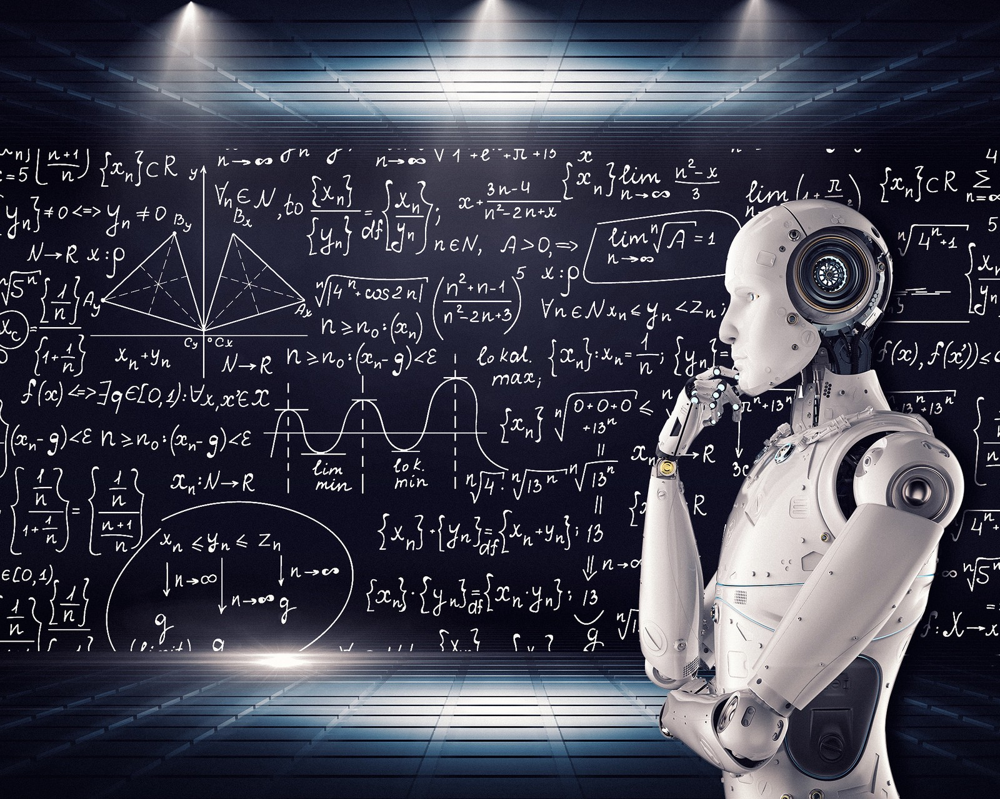
Loan Prediction System
By:-
1. Adnan Shaikh (68)
2. Kanchan Mengune (37)
3. Zeeshan Ansari (03)
4. Binitdev Pandey (48)
UNDER THE GUIDANCE OF
Prof. Shatabdi BhaLERAO

Slide 2
Index
1. Introduction
3. Model
4. ML Algorithms
2. Data
5. Tools

Slide 3
1. Introduction
In today’s fast growing world everyone gets to the point where they need loan for something, in Banking, Car or any other system which gives their customers loan benefits according to their status, as technology is getting better day by day customers can apply for the loan through online system (Website or App) because of this large data (10,000+) can be piled up it will be difficult for any employee to evaluate all customers information (as well as giving additional salary just for passing loan) and depending on that approving their loan, it is necessary to have something at hand which can check whether to approve loan or not without interference of human.
So, keeping this in mind we created ML (Machine Learning) Loan Prediction Project which can approve loan to customers depending on the necessary information they provide.
This project goes through many steps from pre-processing data in proper format to transforming it to suitable format for applying ML algorithms, after transformation different ML algorithms are applied, selecting patterns of the algorithm which have highest accuracy and finally applying patterns on Test Dataset to predict whether to approve loan or not.

Slide 4
2. Data
For this project, we have three CSV files: train, test, and sample submission extracted from Git & Kaggle Repository.
Train file will be used for training the model, i.e. our model will learn from this file. It contains all the independent variables and the target variable.
Test file contains all the independent variables, but not the target variable. We will apply the model to predict the target variable for the test data.
Sample submission file contains the format in which we have to submit out predictions

Slide 5
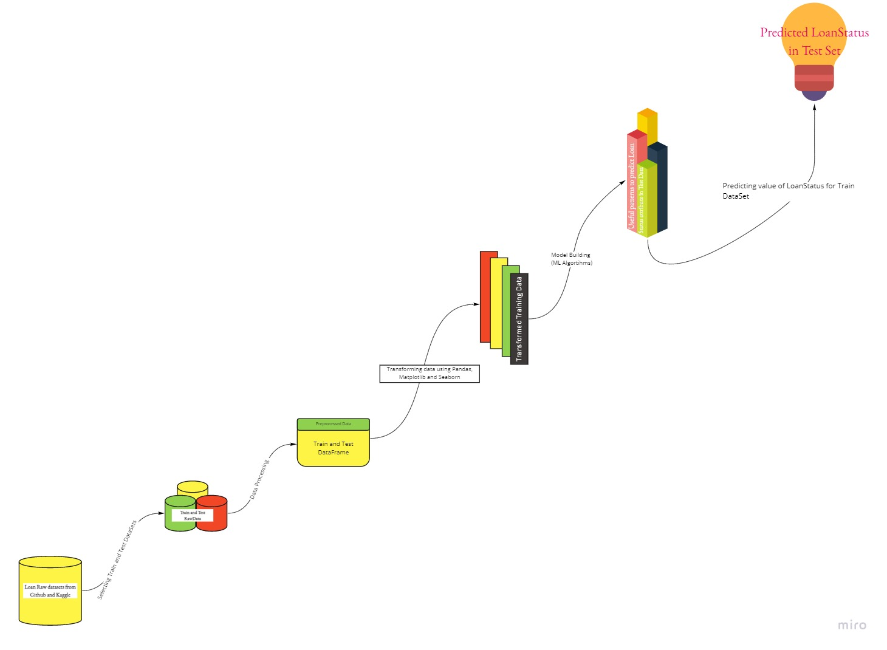

3. Model:

Slide 6
4. ML Algorithms
Following ML Algorithms are going to be used in Loan prediction system:
Logistic regression
Decision tree
Random Forest

Slide 7
5. Tools
Python
Pandas
Numpy
Matplotlib
Seaborn
Sklearn

